Slide 1

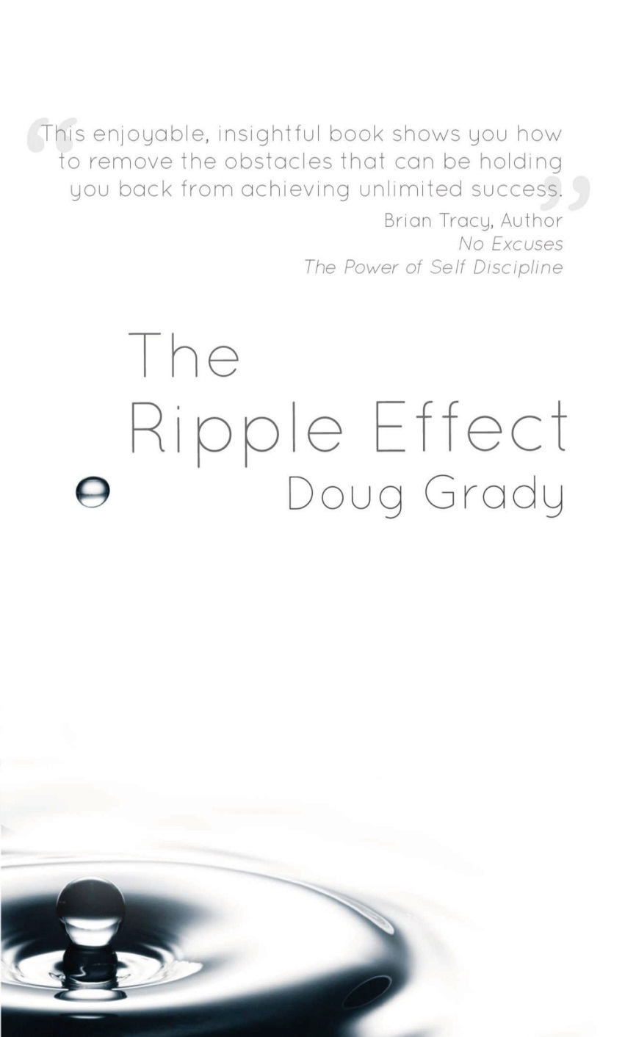
One simple choice
can change the course
of your life.
Choose powerfully!
Doug Grady
@douggrady
www.DougGrady.com

Slide 2
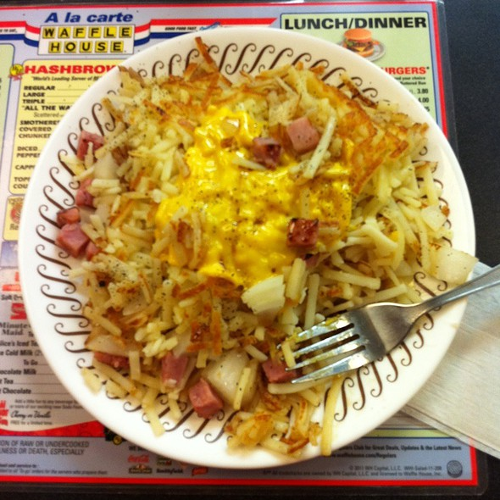
Scattered, Smothered and Covered…

Slide 3
The Magic in the Minimum
Criteria:
More
Manageable
Medium term

Slide 4
How to Create a Ripple Effect
Choose
Stay the Course
Pay attention

Slide 5
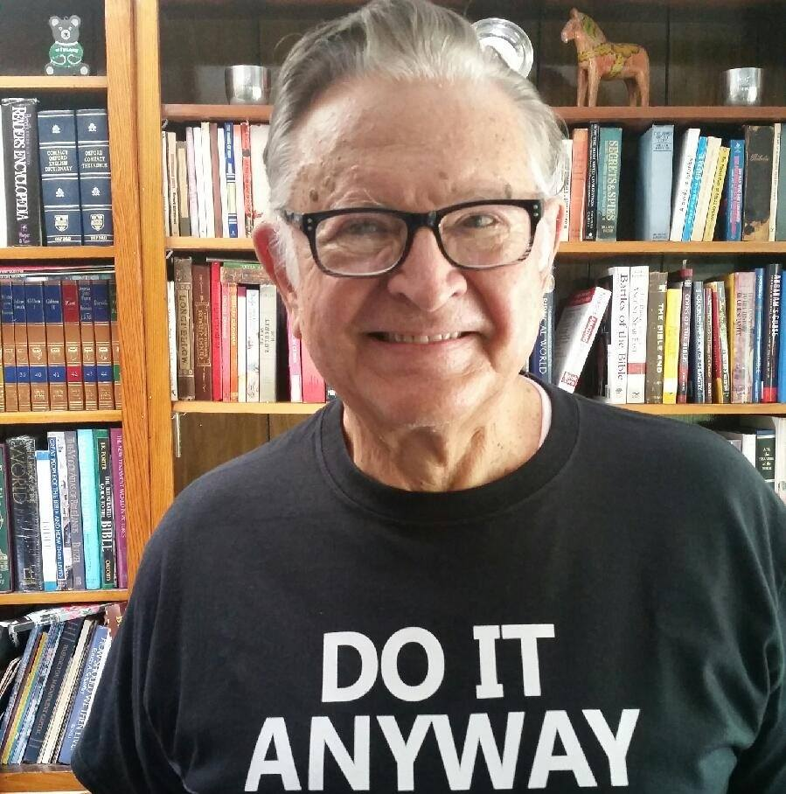

Slide 7


Slide 8
Choose Simply
#ChoosePowerfully
Choose NOW!
#DoItAnyWay
@douggrady www.DougGrady.com

