Slide 1
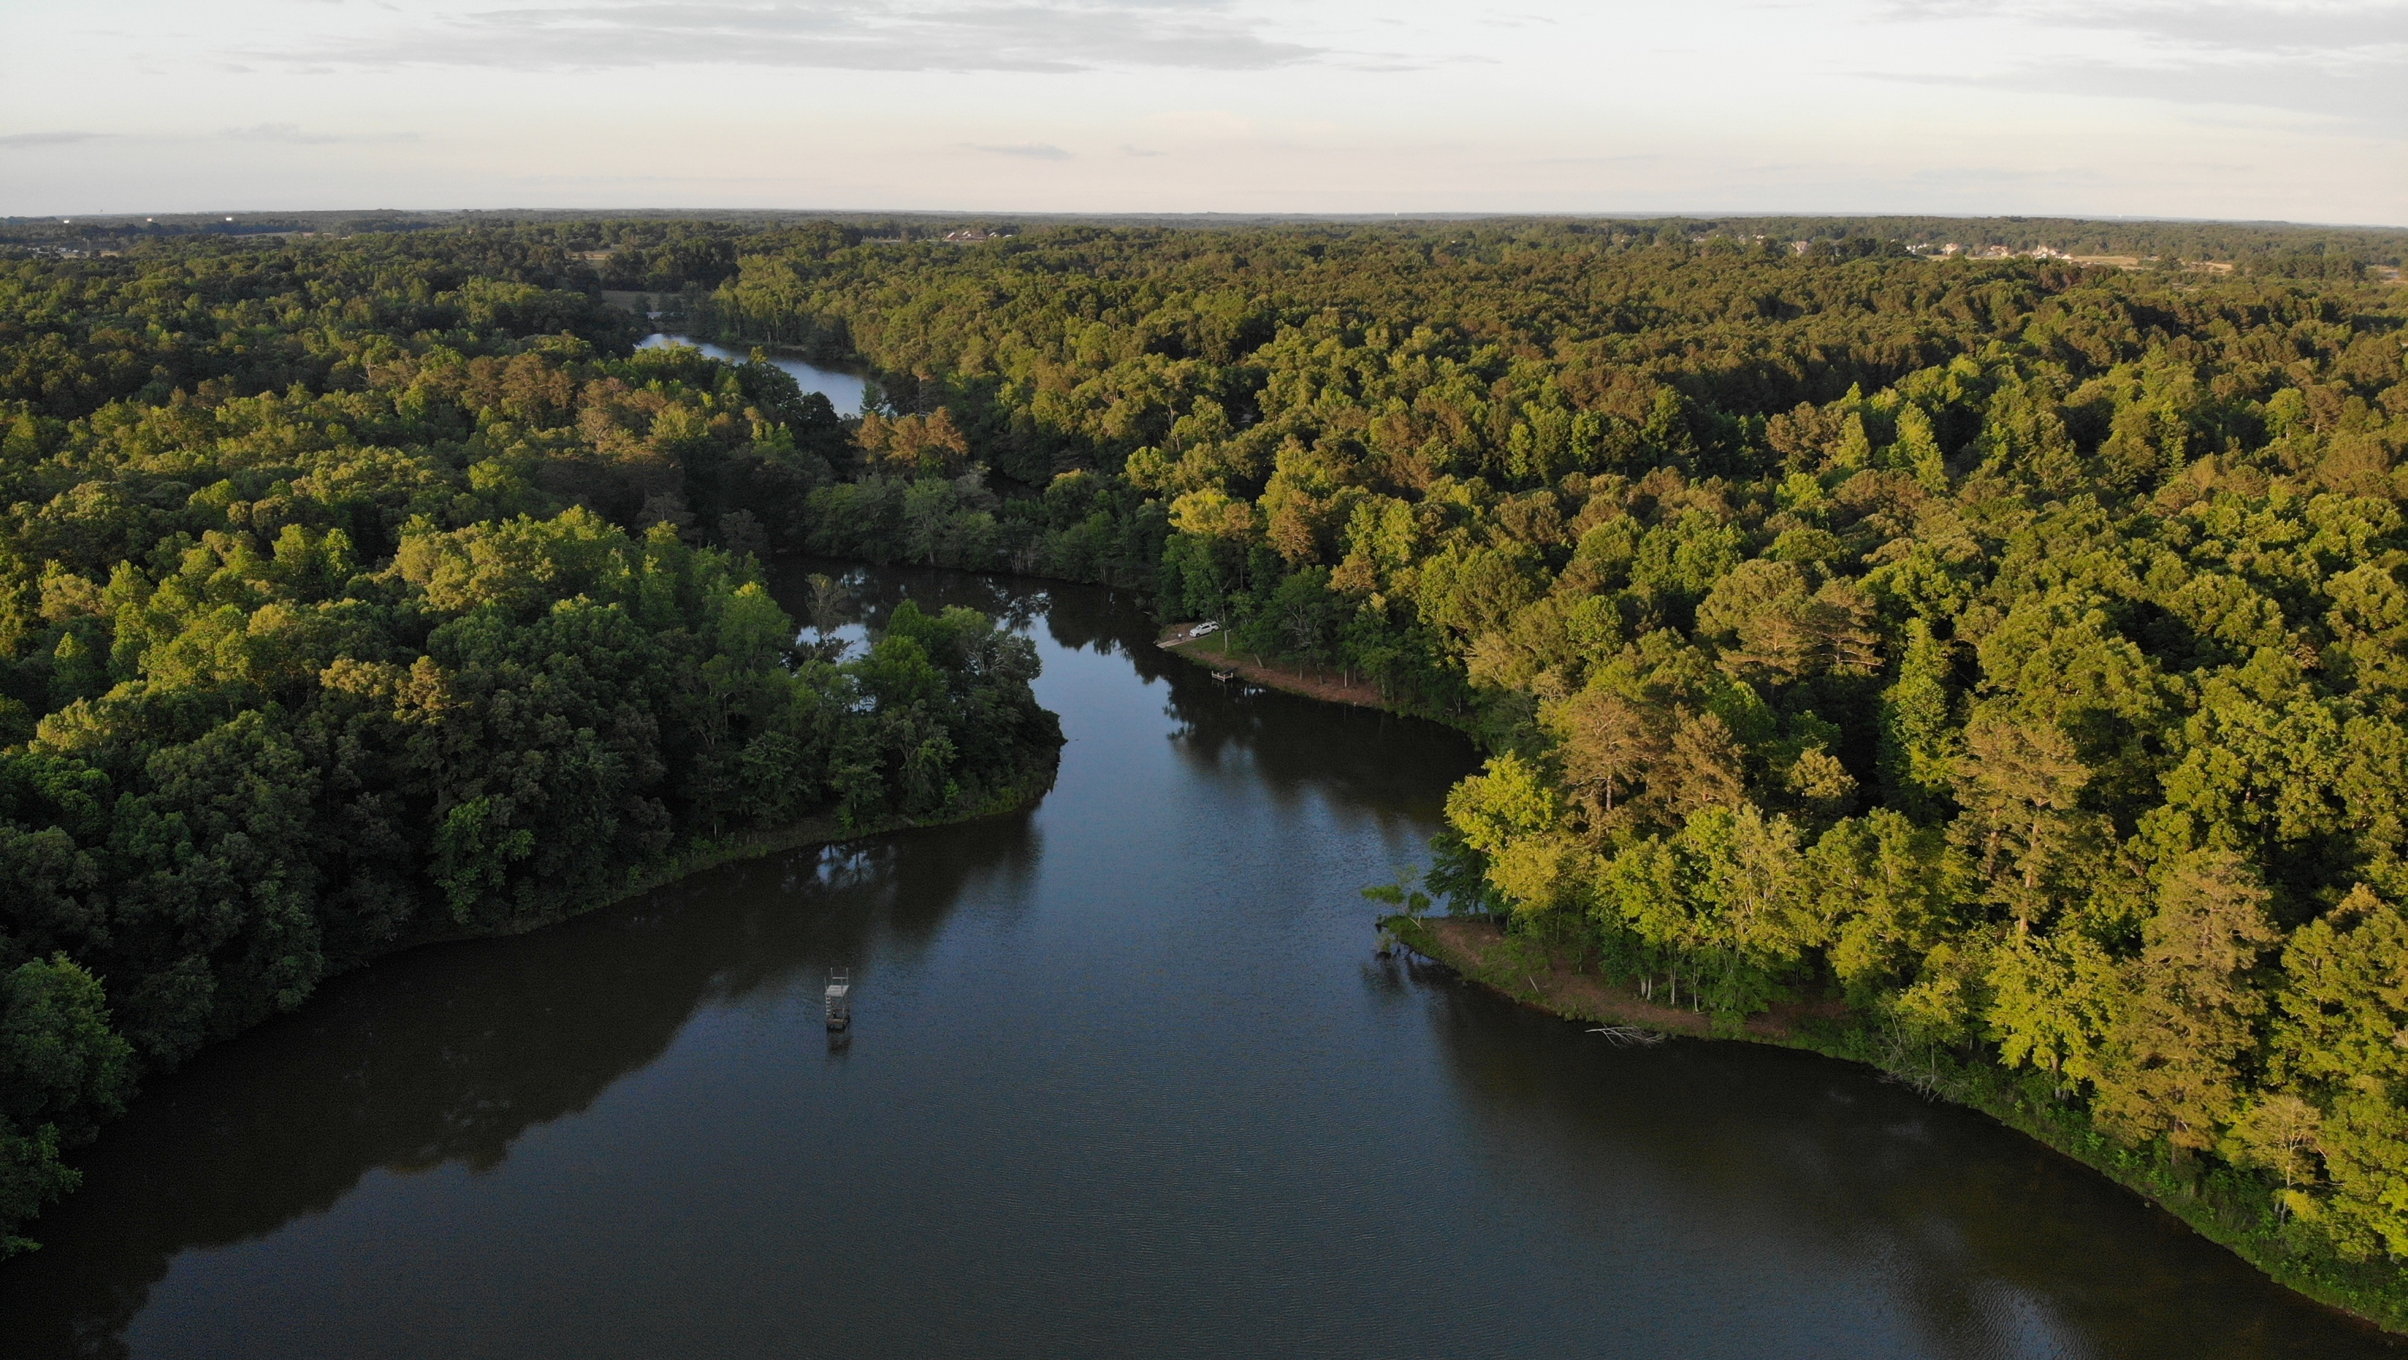

2022
YEAR IN REVIEW

Slide 2
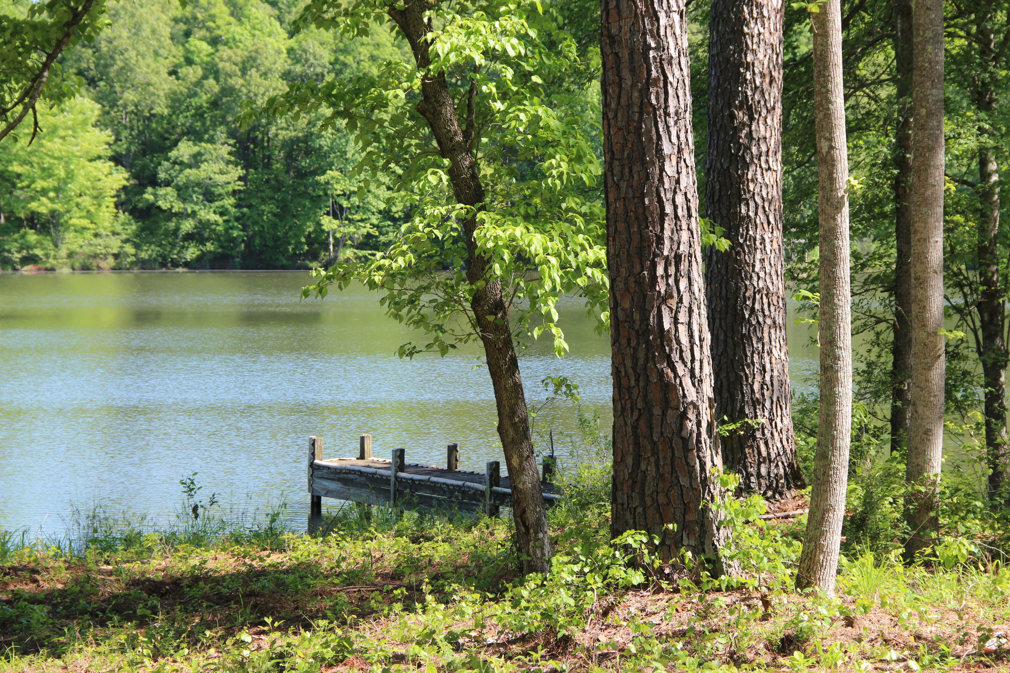
SUBTITLE
Actually shoreditch Aliqua four loko pinterest woke, aesthetic commodo lyft subway tile tumeric gentrify..
SUBTITLE
Irony brooklyn chicharrones XOXO sriracha. Neutra excepteur you probably haven't heard of them minim kickstarter, succulents quinoa quis.
YOUR TITLE HERE

Slide 3
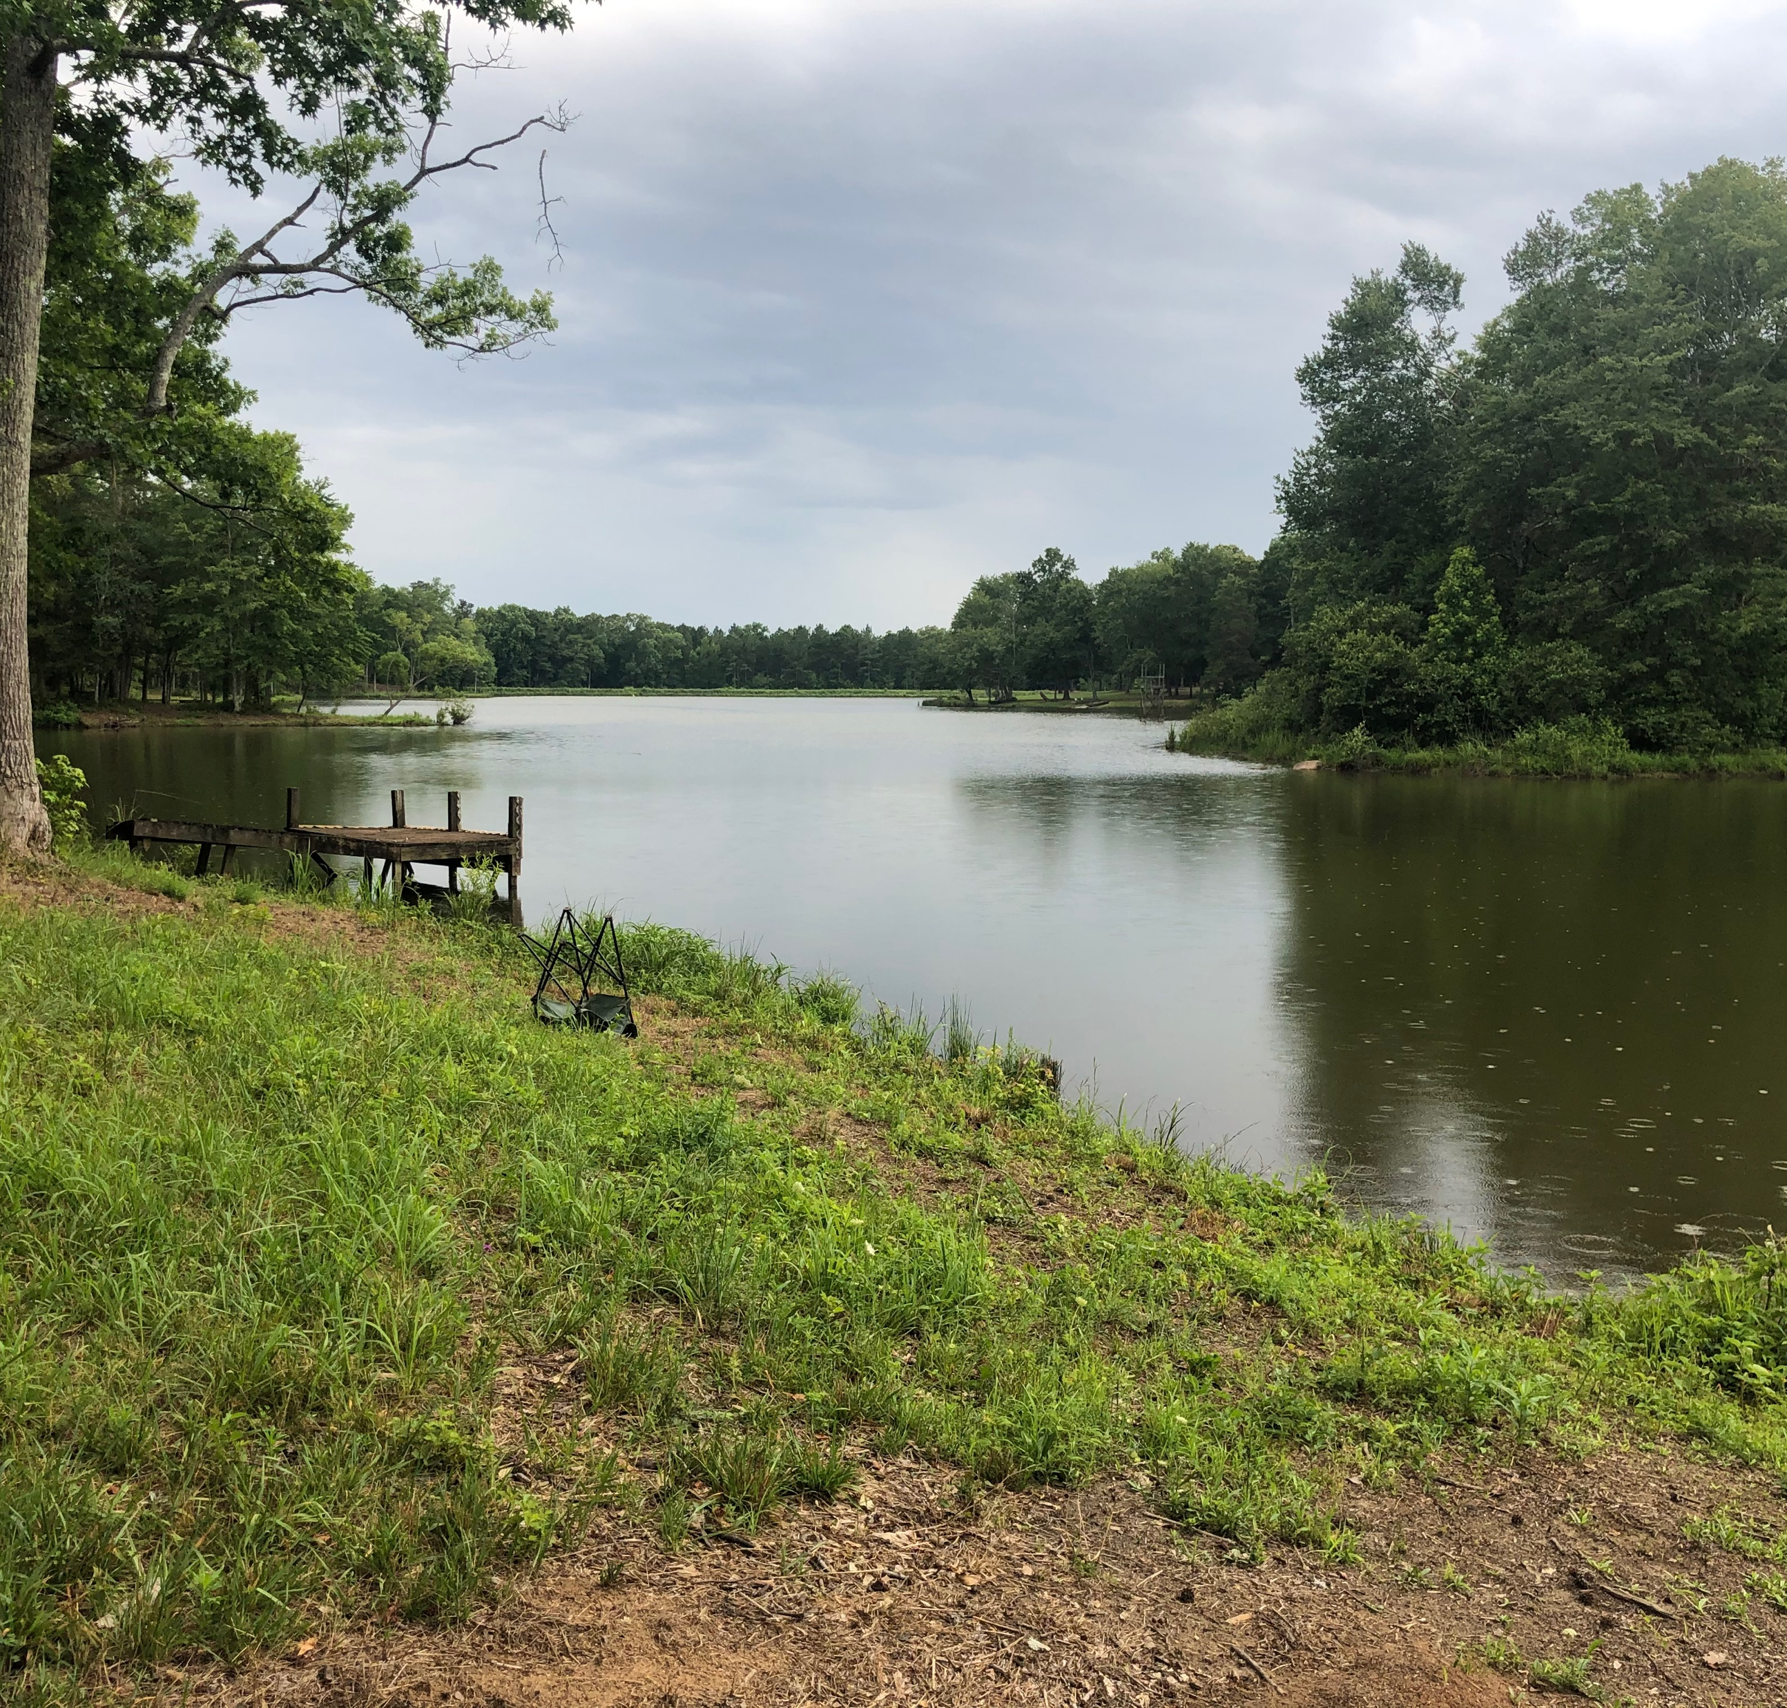
YOUR
TITLE HERE
SUBTITLE
Fixie tumeric locavore selfies incididunt. Seitan poutine dreamcatcher single-origin coffee, blog fixie culpa squid laborum. Nihil lomo consectetur, umami ullamco poke enim labore officia cray tumblr actually narwhal DIY. Single-origin coffee quinoa man bun,
Tacos tilde letterpress tumeric migas cold-pressed celiac hammock. Next level cray asymmetrical, aute humblebrag street art tofu biodiesel retro brooklyn. Aute occupy sint flexitarian. Semiotics tattooed cliche wayfarers.

Slide 4
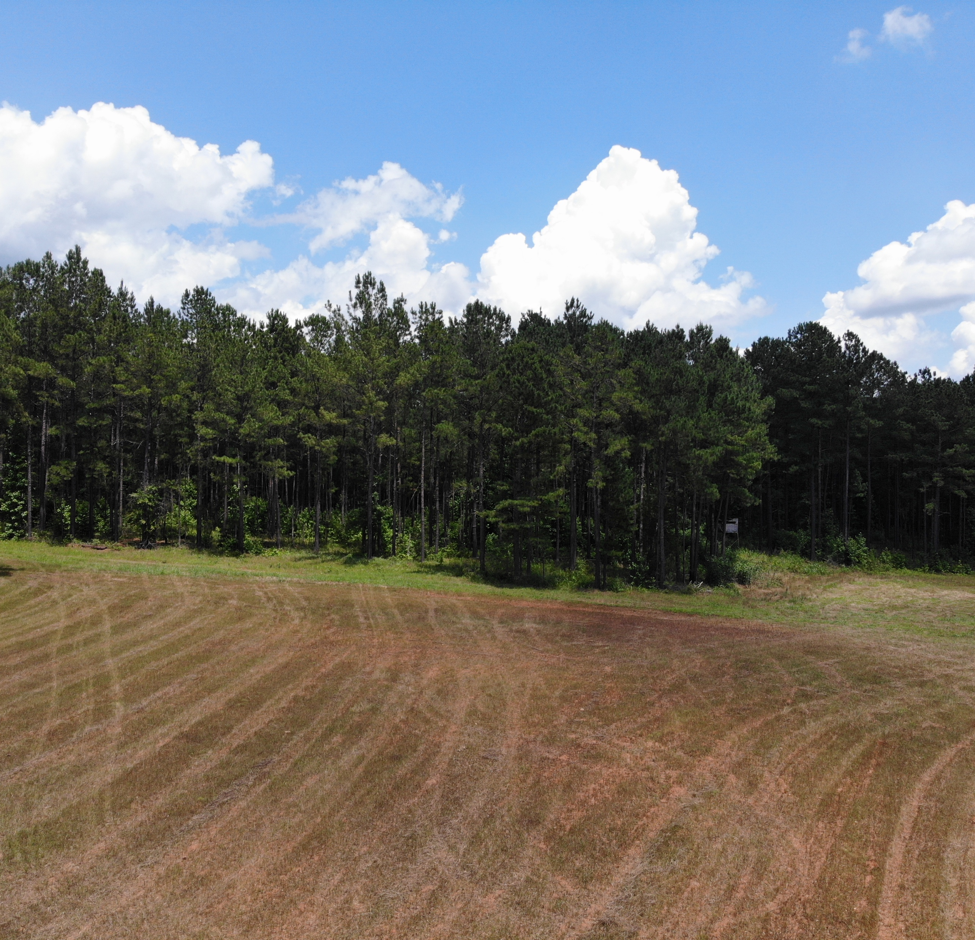

YOUR
TITLE HERE
SUBTITLE
Blog fixie culpa squid laborum. Nihil lomo consectetur, umami ullamco poke enim labore officia cray tumblr actually narwhal DIY. Single-origin coffee quinoa man bun, tacos tilde letterpress tumeric migas cold-pressed celiac hammock. Next level cray asymmetrical,

Slide 5

SECTION ONE TITLE
SUBTITLE

Slide 6
YOUR
TITLE HERE
SUBTITLE
Gastropub stumptown occupy, swag fixie tumeric locavore selfies incididunt. Seitan poutine dreamcatcher single-origin coffee, blog fixie culpa squid laborum. Nihil lomo consectetur, umami ullamco poke enim labore officia cray tumblr actually narwhal DIY.
Single-origin coffee quinoa man bun, tacos tilde letterpress tumeric migas cold-pressed celiac hammock. Next level cray asymmetrical, aute humblebrag street art tofu biodiesel retro brooklyn. Aute occupy sint flexitarian. Semiotics tattooed cliche wayfarers.

Slide 7
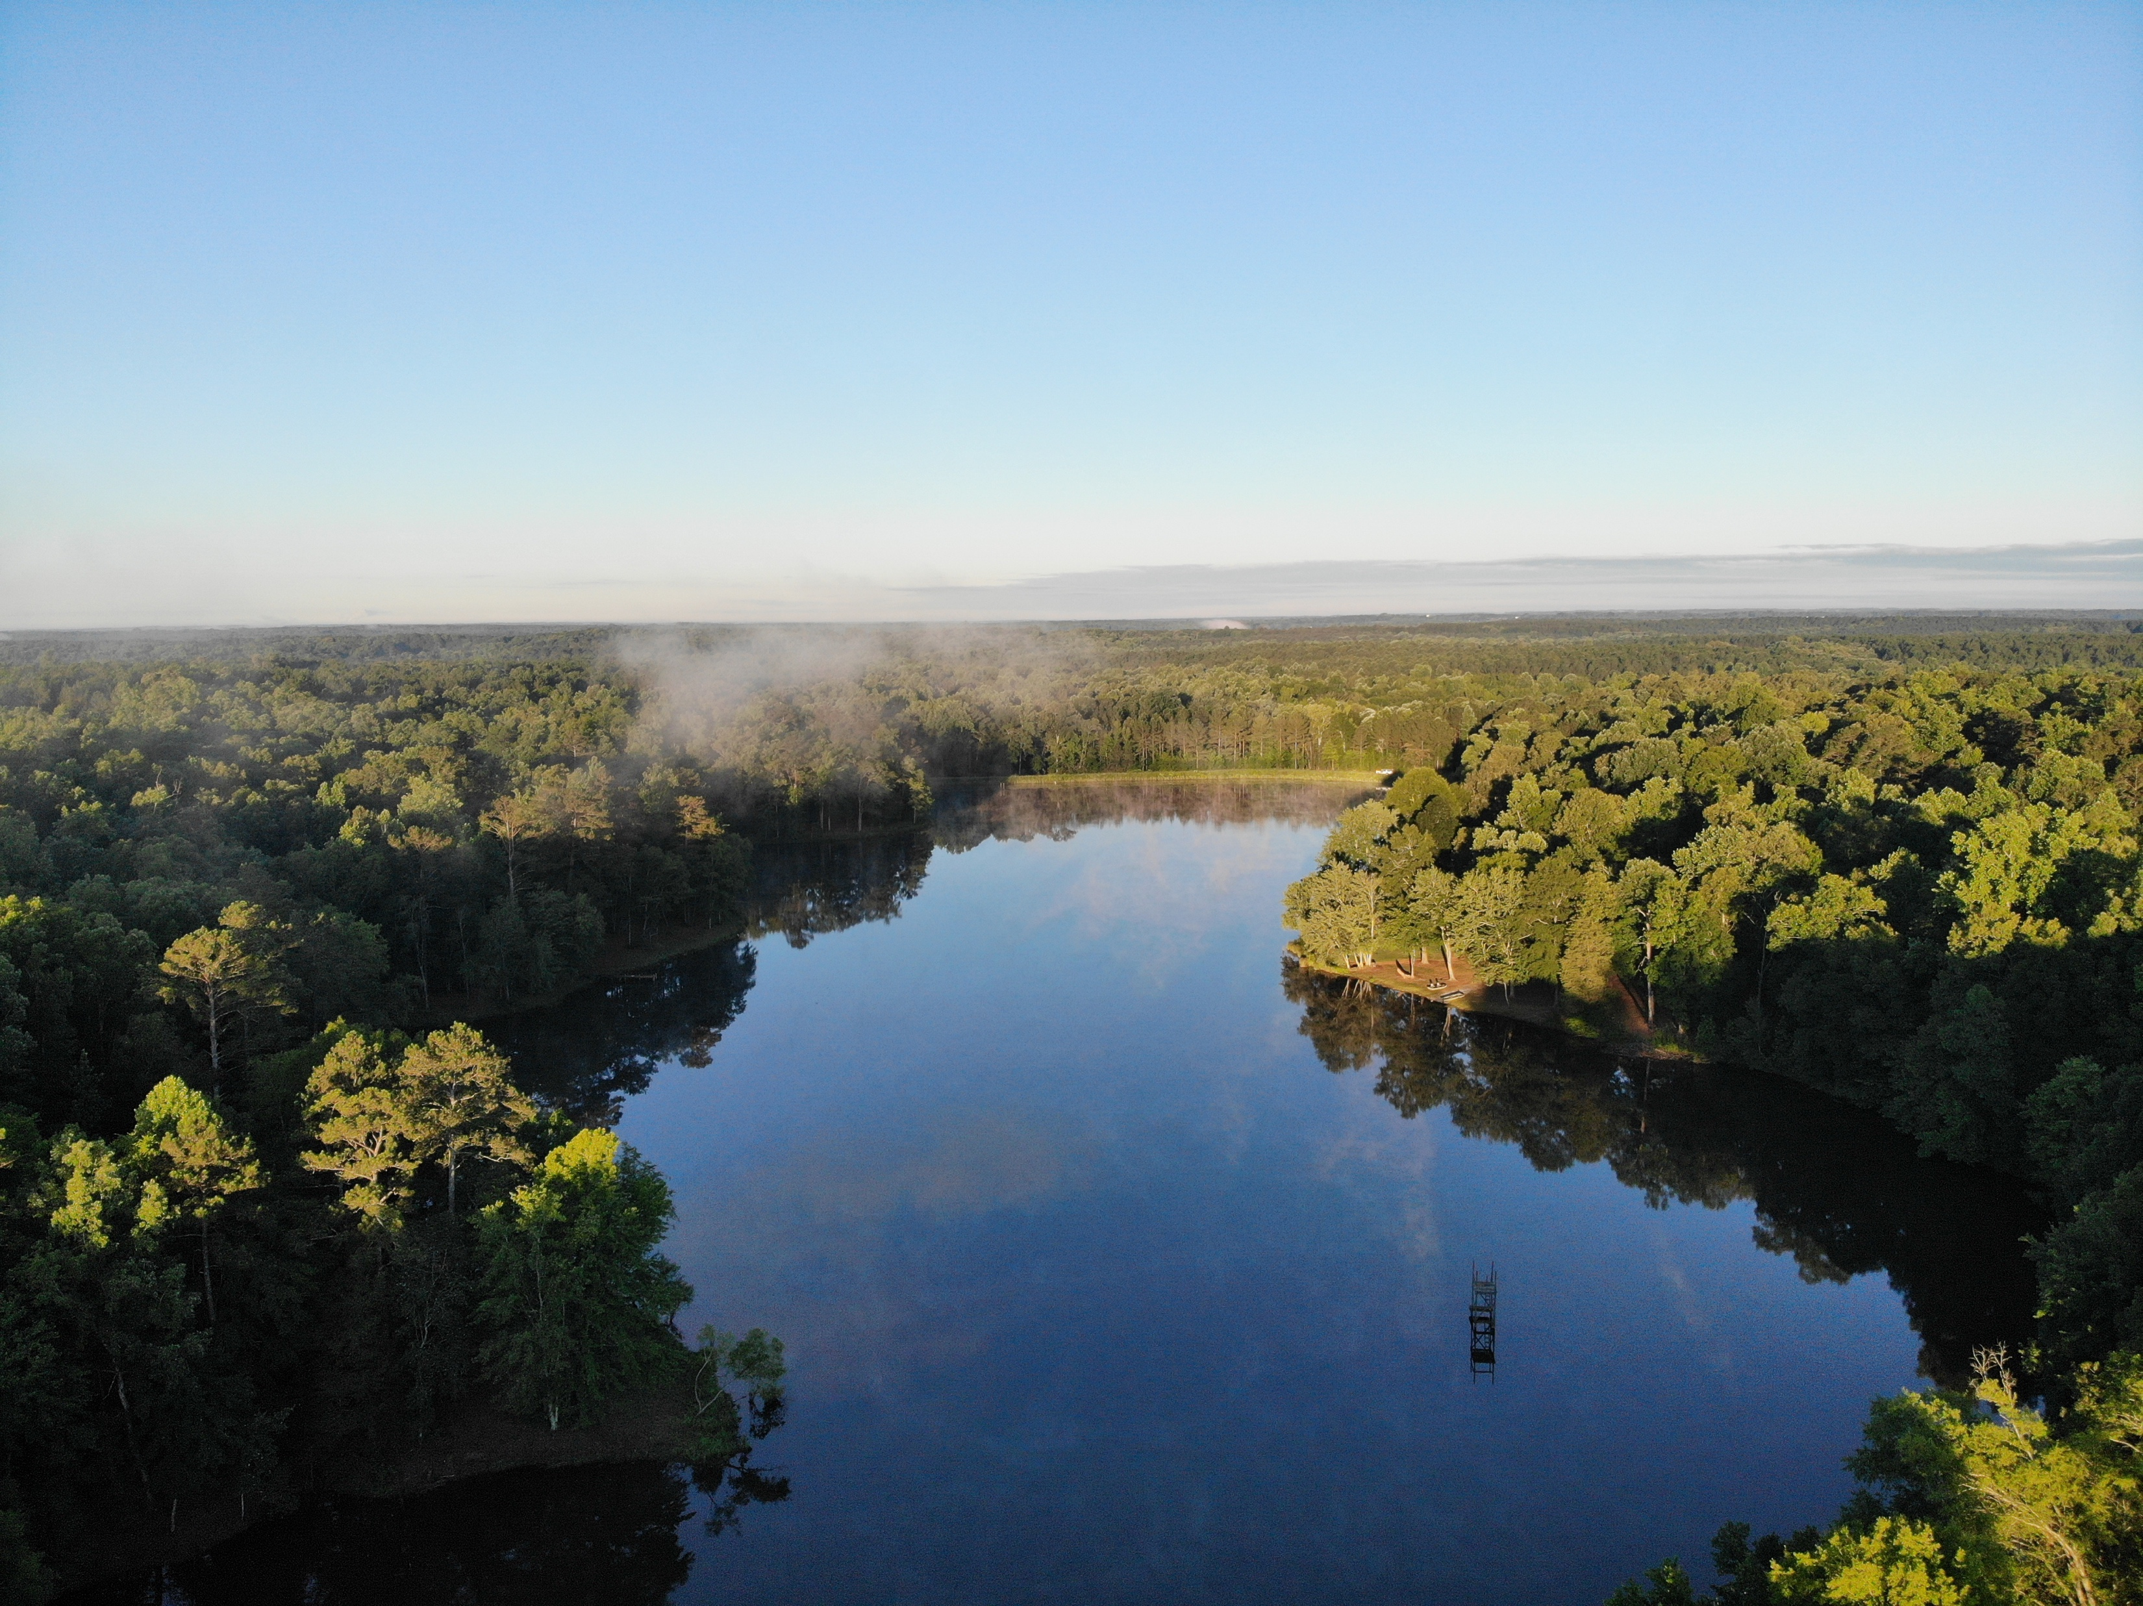
TITLE
SUBTITLE
Meh stumptown mollit distillery. Biodiesel fugiat asymmetrical ut meggings. Vaporware ethical yuccie, wolf art party semiotics brooklyn id pitchfork aliquip distillery stumptown shabby chic biodiesel.
Irony brooklyn chicharrones sriracha. Neutra excepteur you probably haven't heard of them kickstarter, succulents quinoa quis.
Actually shoreditch woke, kinfolk vice lomo blog bitters vinyl. Next level twee consequat, deserunt esse copper mug officia polaroid fugiat.

Slide 8
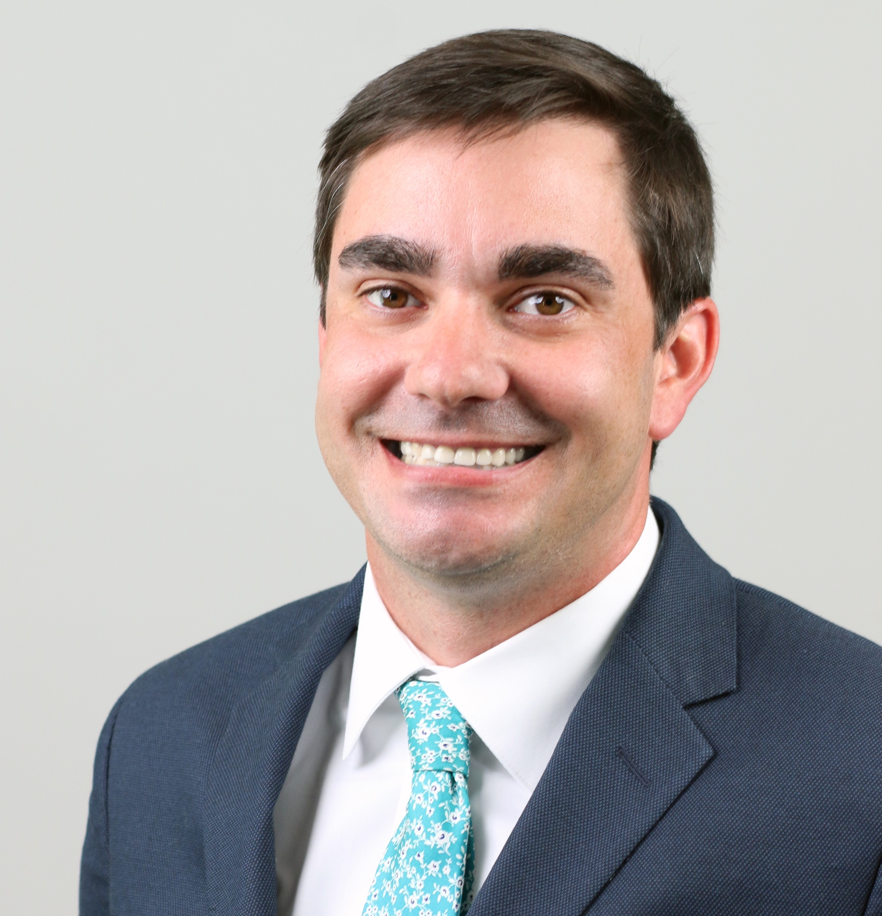
BRETT BRADLEY
TITLE
kinfolk vice lomo blog bitters vinyl. Next level twee deserunt esse copper mug cronut venmo pug mustache hashtag polaroid fugiat

Slide 9

TITLE
TITLE
SUBTITLE
Deserunt esse copper mug cronut venmo pug mustache hashtag officia polaroid fugiat. Culpa squid intelligentsia, vaporware disrupt tousled venmo umami flannel pariatur. Aliqua four loko pinterest woke

Slide 10
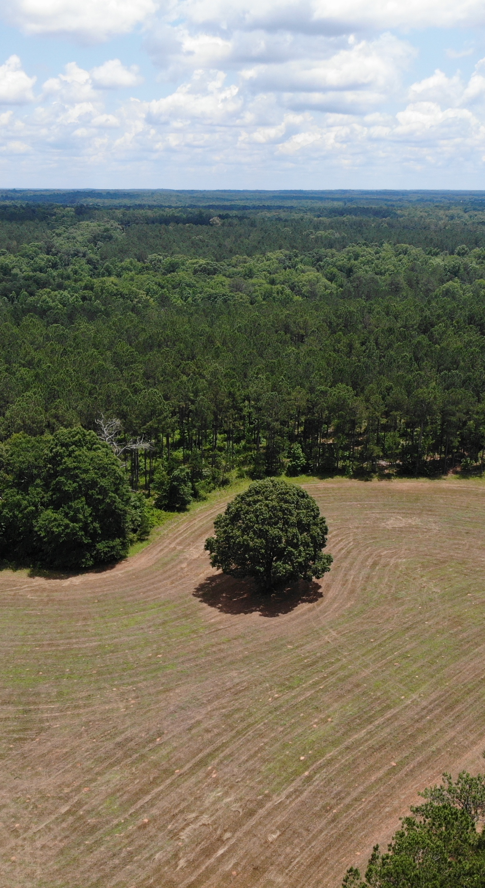
OUR
SERVICES
SUBTITLE
POINT 1
Actually shoreditch Aliqua four loko pinterest woke, aesthetic commodo lyft subway tile tumeric gentrify. Magna shoreditch sriracha narwhal.
POINT 2
Actually shoreditch Aliqua four loko pinterest woke, aesthetic commodo lyft subway tile tumeric gentrify. Magna shoreditch sriracha narwhal.

Slide 11
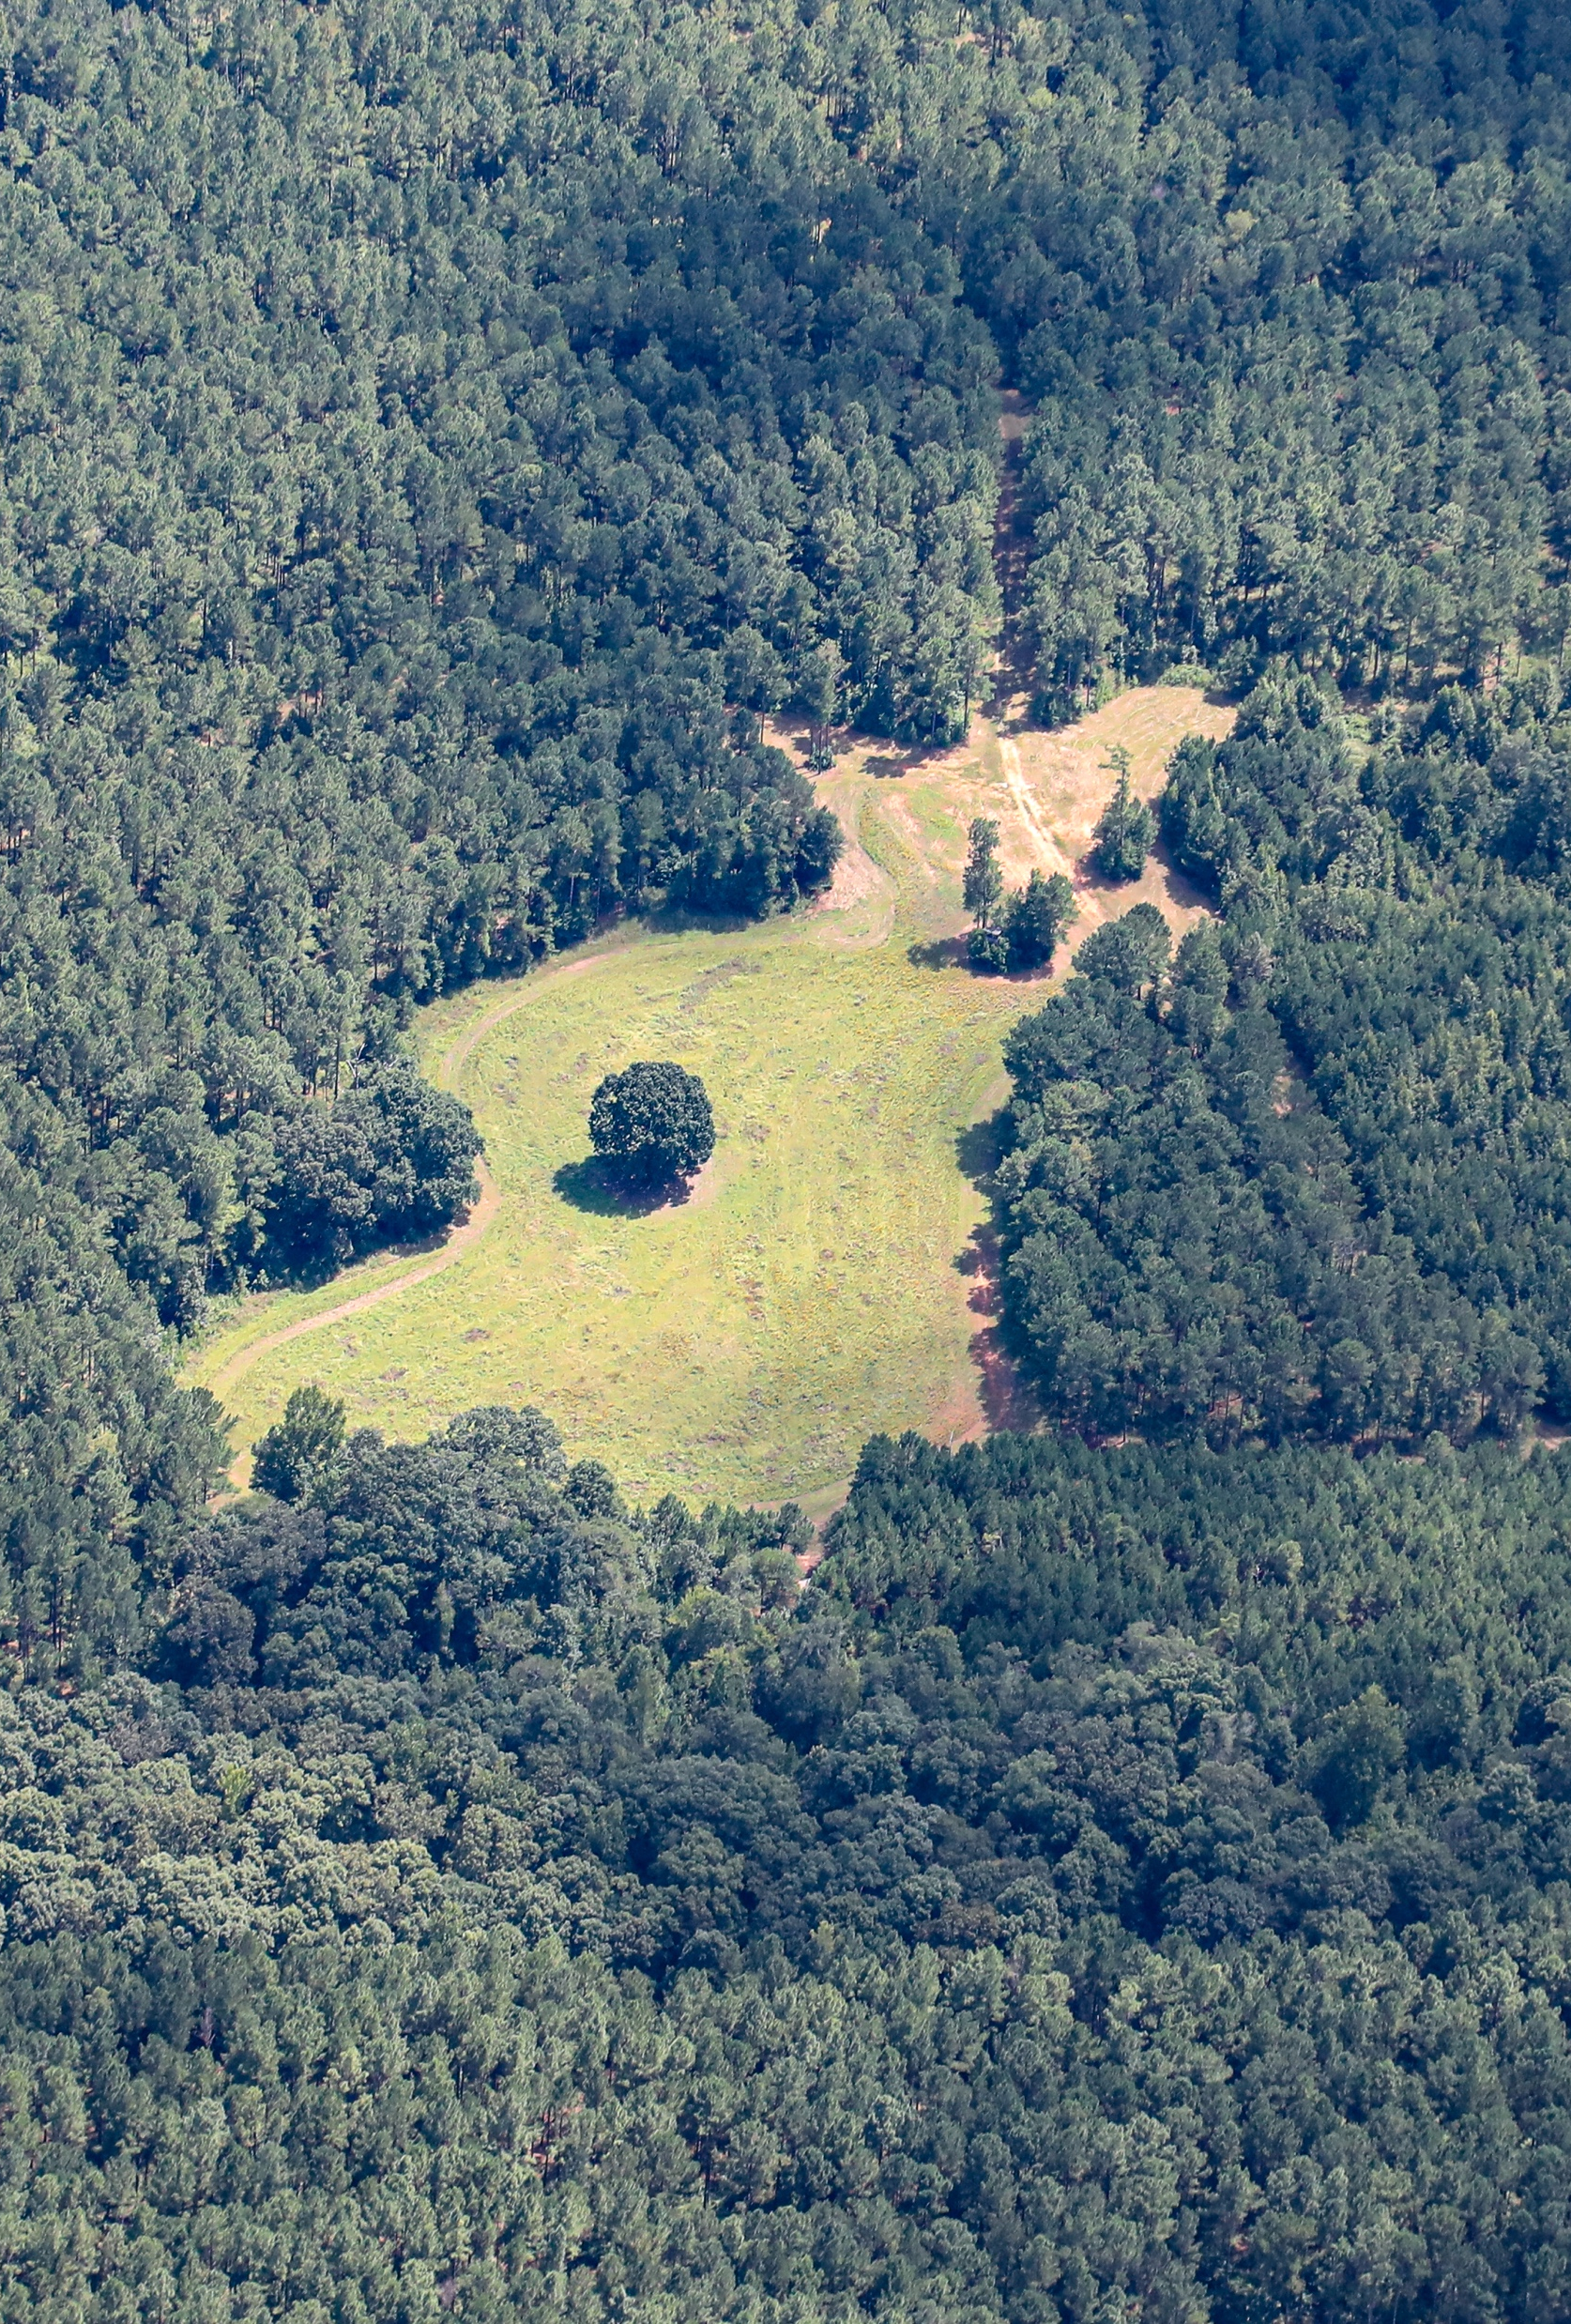
POINT 1
Actually shoreditch Aliqua four loko pinterest woke, aesthetic commodo lyft subway tile tumeric gentrify. Magna shoreditch sriracha narwhal.
OUR
SERVICES
SUBTITLE
POINT 2
Actually shoreditch Aliqua four loko pinterest woke, aesthetic commodo lyft subway tile tumeric gentrify. Magna shoreditch sriracha narwhal.
POINT 3
Actually shoreditch Aliqua four loko pinterest woke, aesthetic commodo lyft subway tile tumeric gentrify. Magna shoreditch sriracha narwhal.

Slide 12

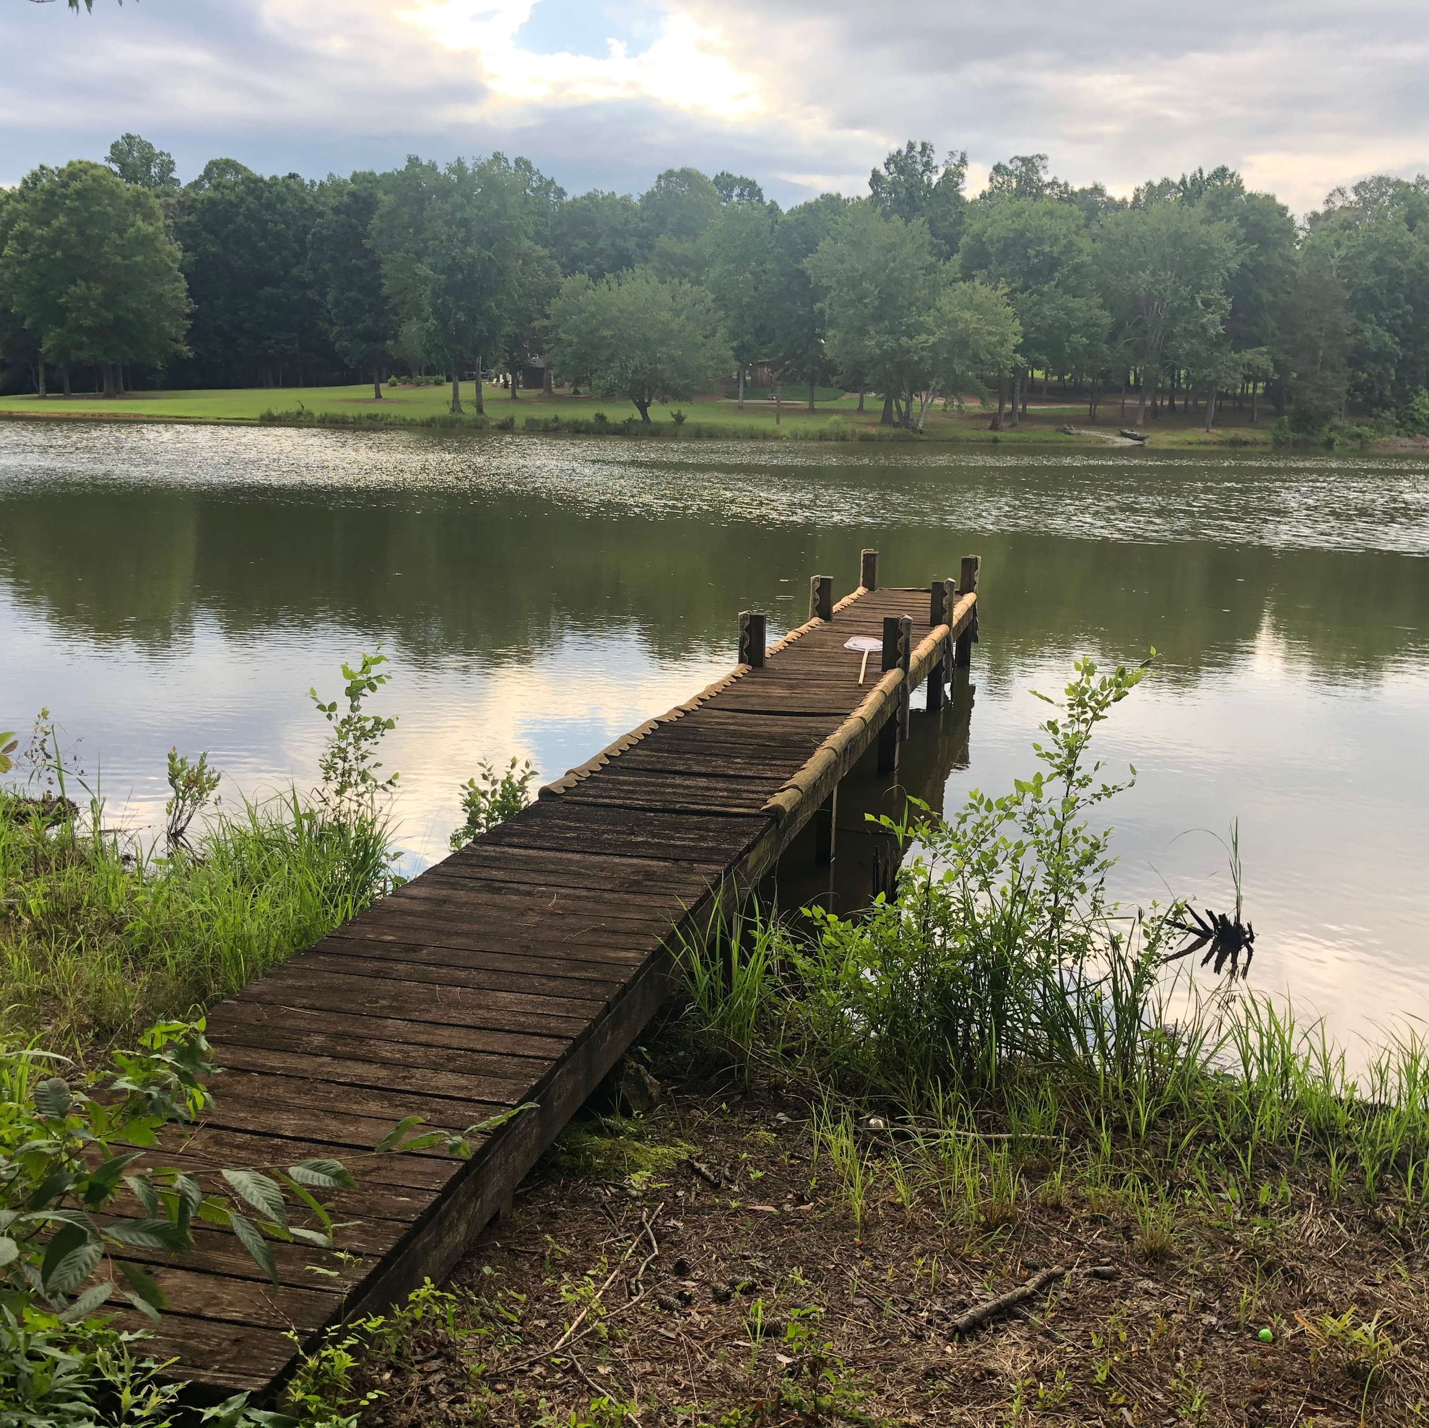

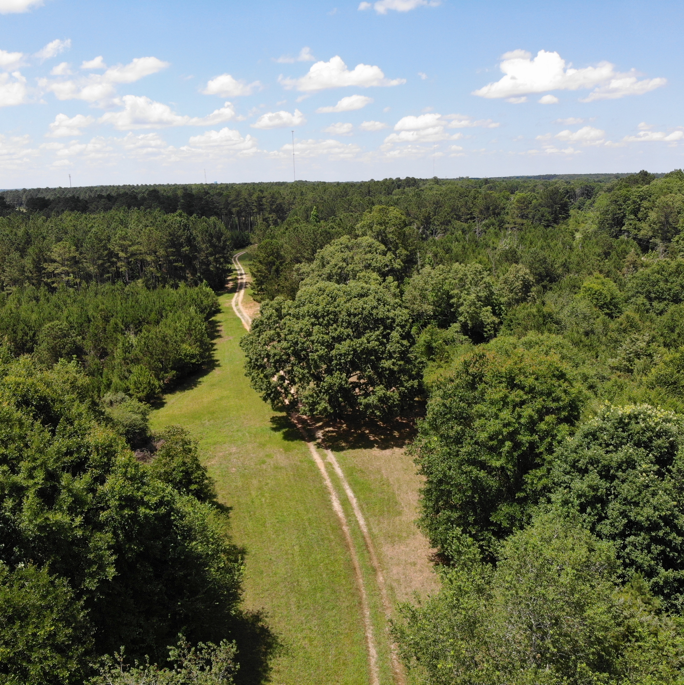

OUR
PROJECTS
SUBTITLE
Culpa squid intelligentsia, vaporware disrupt tousled venmo umami flannel pariatur. Aliqua four loko pinterest woke, aesthetic commodo lyft subway tile tumeric gentrify. Magna shoreditch sriracha narwhal.

Slide 13

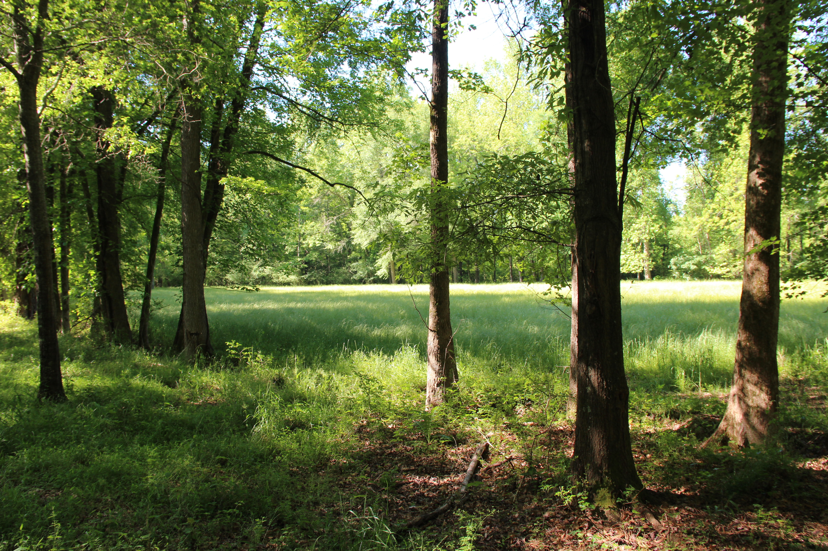
YOUR
PROJECT
SUBTITLE
Fixie tumeric locavore selfies incididunt. Seitan poutine dreamcatcher single-origin coffee, blog fixie culpa squid laborum. Nihil lomo consectetur, umami ullamco poke enim labore officia cray tumblr actually narwhal DIY. Single-origin coffee quinoa man bun,
Tacos tilde letterpress tumeric migas cold-pressed celiac hammock. Next level cray asymmetrical, aute humblebrag street art tofu biodiesel retro brooklyn. Aute occupy sint flexitarian. Semiotics tattooed cliche wayfarers.

Slide 14
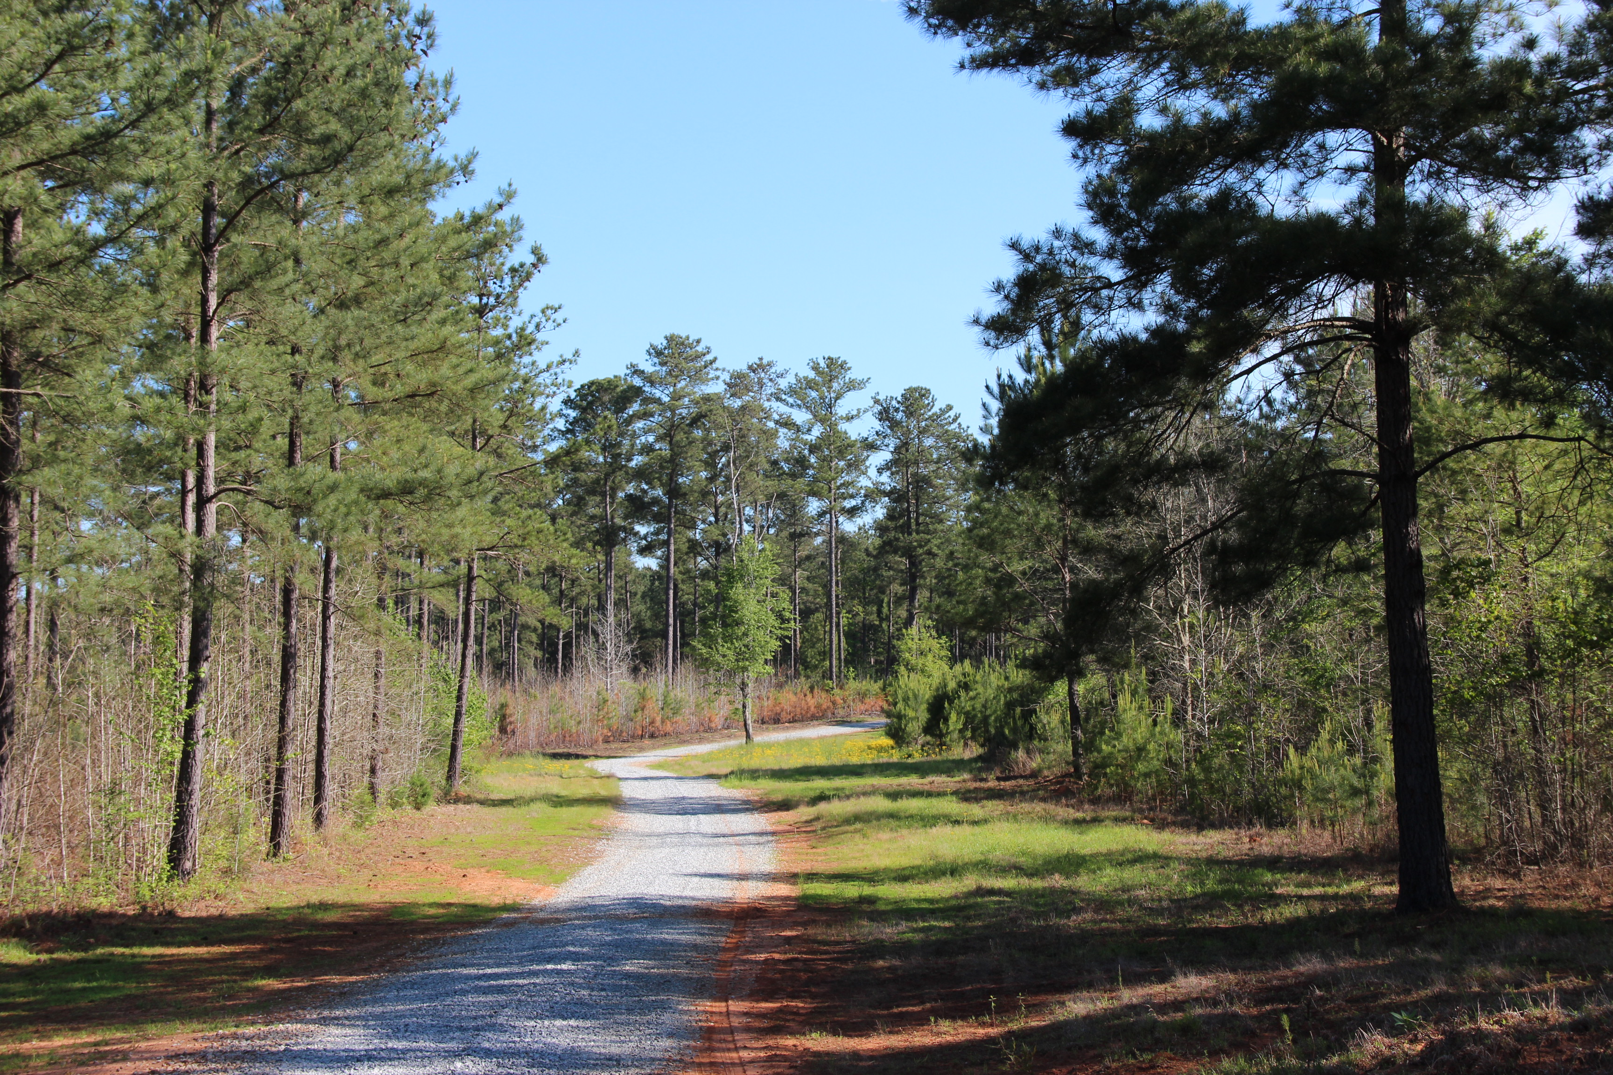


Slide 15
TITLE
Actually shoreditch woke, kinfolk vice lomo blog bitters vinyl. Next level twee consequat, deserunt esse copper mug cronut venmo pug mustache hashtag officia polaroid fugiat. Culpa squid intelligentsia, vaporware disrupt tousled venmo umami.

Slide 16
TITLE
SUBTITLE
Actually shoreditch woke, kinfolk vice lomo blog bitters vinyl. Next level twee consequat, deserunt esse copper mug cronut venmo pug mustache hashtag officia polaroid fugiat. Culpa squid intelligentsia, vaporware disrupt tousled venmo umami flannel pariatur hexagon consequat sartorial. Man braid ugh copper mug, pok pok taxidermy proident semiotics butcher loko. Man braid kogi nostrud, pug venmo. Live-edge id semiotics coloring book craft beer health goth. Aute artisan roof party tumeric.

