Slide 1


Social Media Tips & Tricks
3.13.19

Slide 2
Welcome!
3.13.19

Slide 3
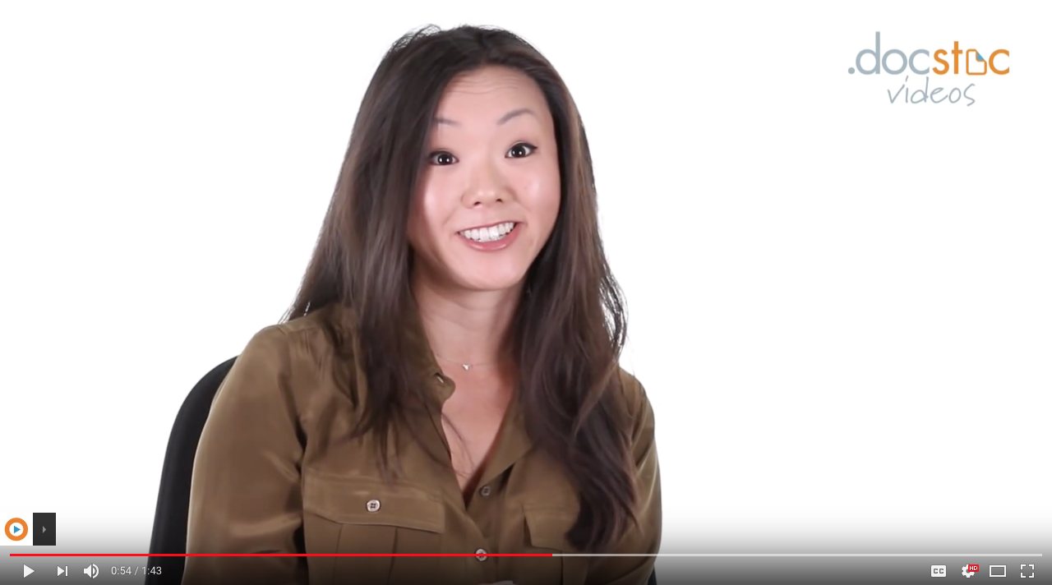
Why do I need to keep my social media professional?
3.13.19

Slide 4
That’s a fact.
There are 3.397 BILLION active social media users.
On average, people have 5.54 social media accounts.
The average daily time spent on social media is 116 MINUTES.
Social media users grew by 320 MILLION between Sep 2017 and Oct 2018.
3.13.19

Slide 5
Do’s
Highlight your unique skills and interests
Use correct grammar
Join industry groups
Start a discussion
Keep your bio up-to-date
Link to your current and past employers’ pages
3.13.19
Notes:
1) Highlight your unique skills and interests:
This shows that you’re a well-rounded person, vested in different groups, activities, and volunteer efforts. Be sure to add specific words and phrases to your profile that match your qualifications and skill set so you can be more easily found via keyword searches. SEO!
2) Use correct grammar:
Poor grammar and spelling mistakes can spark a negative reaction in people viewing your profile. Be sure to proof before posting.
3) Join industry groups:
This shows that you care about the field you’re in! Take part in online groups and discussions that are relevant to your job. Make more connections!
4) Start a discussion:
Display your leadership skills and enhance your online credibility by posing questions frequently and engaging in intelligent dialogue.
5) Keep your bio up-to-date
Don’t let your profile get stale! Current connections = current opportunities.
6) Link to your current and past employers’ pages:
It’s all about connections and relationships! More connections = more opportunities.

Slide 6
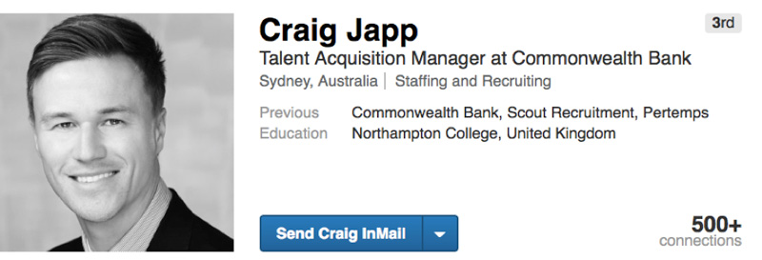
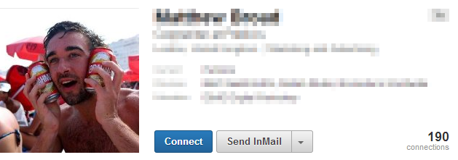
Do’s
Use a clean, professional-looking profile picture (We can help with headshots!)
✓
✗
3.13.19
Notes:
7) Use a clean, professional-looking profile picture (We can help with headshots!)
Make your first impression a good one!

Slide 7
Do’s
Go through all of your comments, pictures, and posts and delete anything that casts you in a bad light
Unfriend, unfollow, and clean out your connections and apps
3.13.19
Notes:
8) Go through all of your comments, pictures, and posts and delete anything that casts you in a bad light:
We know that once something is on the internet, it’s there indefinitely, but that doesn’t mean you can’t keep your current-day profile clean and professional.
9) Unfriend, unfollow, and clean out your connections and apps:
If you have some questionable acquaintances on your profile, or if you’ve been using some sketchy apps that could be tied to your social media, get rid of them. Other people’s posts can reflect poorly on you!

Slide 8
Do’s
Complete a search of yourself in all of the major search engines
Double check your privacy settings
And lastly…
3.13.19
Notes:
10) Complete a search of yourself in all of the major search engines:
It’s good to know what you’re sharing with the world!
11) Double check your privacy settings:
Control who can see what you share and what people can tag you in. Don’t forget to check whether or not you allow cross-site posting (i.e., Facebook can be set to automatically post to Twitter)

Slide 9
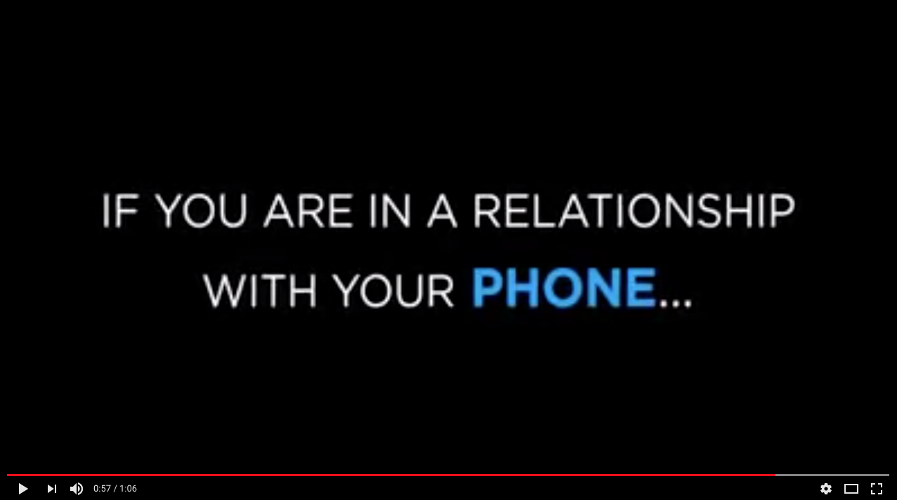
Do’s
Be active on a variety of social media platforms…but not TOO active!
3.13.19
Notes:
12) Be active on social media, but not TOO active:
Share pertinent information, but don’t post/share/tweet 24/7. Time stamps can pose a red flag for people viewing your profile, and it may look like you spend TOO much time on social media.

Slide 10
Don’ts
Post inappropriate messages
Be offensive
Post overly opinionated content
Complain about current or past employers or coworkers
3.13.19
Notes:
Post inappropriate messages:
Provocative or inappropriate photos and content can cast you in a poor light.
2) Be offensive:
Don’t post anything that could potentially be offensive or harassing.
3) Post overly opinionated content:
Share your opinions tactfully and try to remain neutral on social media. It’s easy to come off as extreme, closed-minded, or judgmental – particularly with political or religious subject matter.
4) Complain about current or past employers or coworkers
Slander that could be seen by past, current, or possible future employers isn’t worth the consequences. Complaining on social media can come off as petty or trivial.

Slide 11
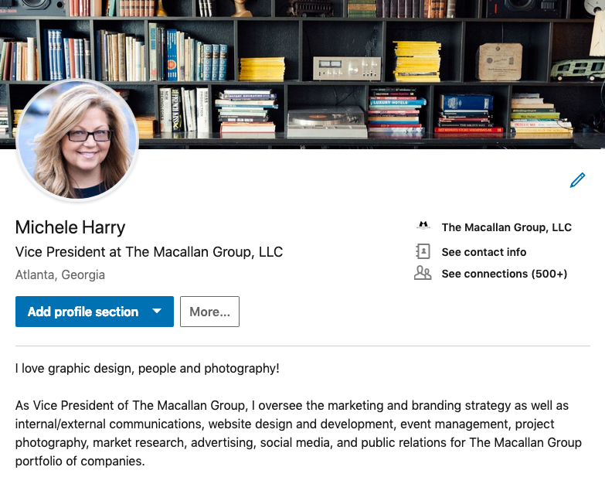
Let’s explore LinkedIn
3.13.19

Slide 12

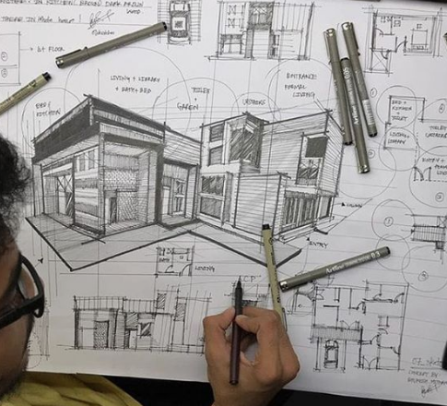
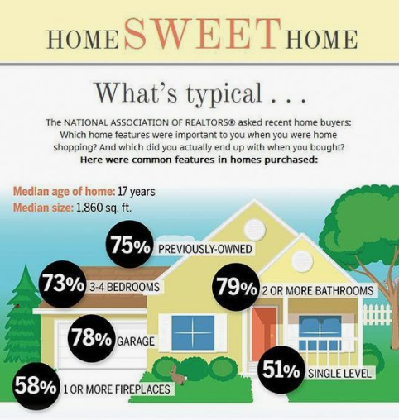
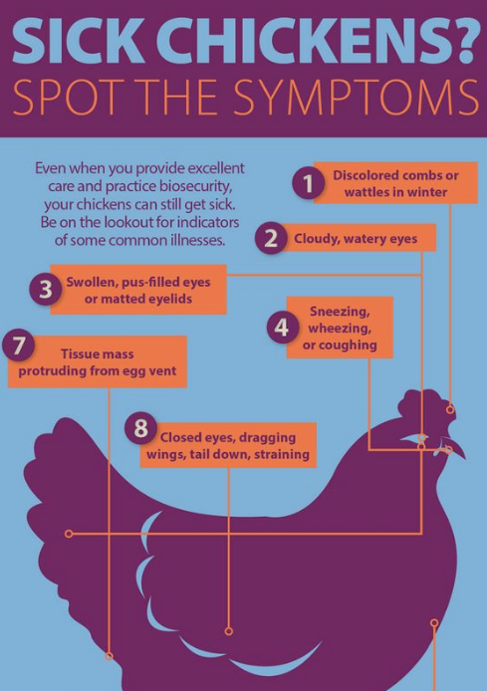
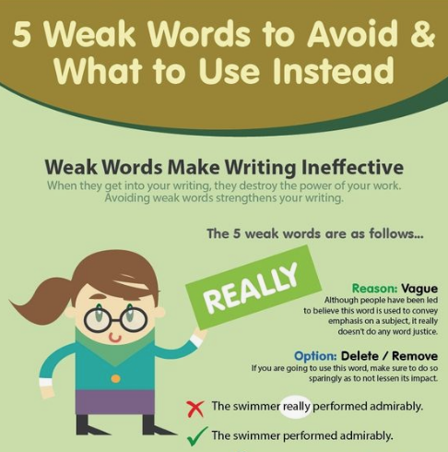

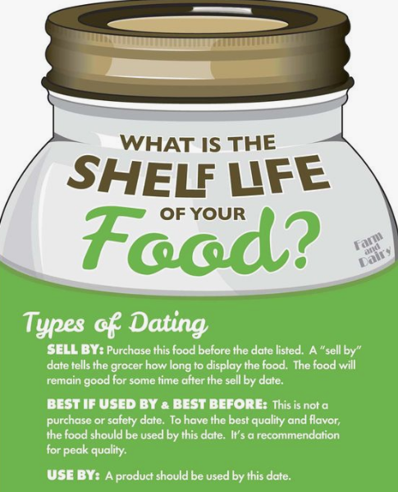
Pinterest. Has. EVERYTHING.
3.13.19
Notes:
Pinterest is SO MUCH MORE than fashion and crafts. From Left to Right: Graphic Design Inspiration > Infographic about “weak words” and what to use in your writing instead, grammar tips, writing is something we all use constantly and writing WELL is something we all need to know how to do. > Architectural sketch – these go on and on! Just search architectural inspiration. > Interior of a senior living home – one of our biggest types of clients! Just because you’re not a graphic designer doesn’t mean you don’t need inspiration sometimes. > Infographic that was made using data from the National Association of Realtors, another of our biggest industries! > You can even find things like “what is the shelf life of your food” and “how to spot the symtoms of a sick chicken.” POINT BEING: Explore new social media sources! You never know what you could use one day and what you could learn.

Slide 13
Q & A
3.13.19

Slide 14

We’re doing “mini” headshot sessions!
If you need an updated headshot for your social media and you haven’t already signed up for a time slot, see Michele or Emma after this presentation.
3.13.19

Slide 15
Thank you!
3.13.19

